Slide 1
Data Migration Techniques

Slide 2
Introduction
Data migration is also called as data transfer.
Data migration means migrating the data from legacy system to SAP system.
The system other than the SAP system is called as legacy system.
Legacy system is also called as Non-SAP system.
Legacy system contains the data which needs to be transferred.

Slide 3
Steps of Data Migration
The various steps of data migration are as follows :
Extracting the data - Extracting the data from the legacy system into a file.
Converting the data - Converting the data to appropriate format. This is called as conversion.
Importing the data - Importing the data in to SAP system.
Verifying the data - Checking the accuracy of data in SAP system.

Slide 4
Data Migration Techniques
The various data migration techniques are as follows :
BDC - Batch Data Communication
LSMW - Legacy System Migration Workbench
BAPI - Business Application Programming Interface

Slide 5
BDC - Introduction
BDC stands for ‘Batch Data Communication’.
The purpose of BDC is to transfer data from Non-SAP(legacy) system to SAP system.
BDC works on the principle of screen recording.
The transaction code for BDC recording is SHDB.

Slide 6
Precautions for Recording
Never use any help(F4 & F1) while recording.
Do not pass wrong values.

Slide 7
BDC Methods
There are 3 BDC methods.
Call transaction method
Session method
Direct input method.
Imp point : Call transaction method and session method are called as batch input methods.

Slide 8
Call Transaction Method
Syntax: CALL TRANSACTION ‘transaction code’ USING <BDC internal table> MODE < A or N or E> UPDATE < A or S or L> MESSAGES INTO <message internal table>.
Example : CALL TRANSACTION 'MM01’ USING lt_bdcdata MODE ‘A’ UPDATE ‘S’ MESSAGES INTO lt_messtab.

Slide 9
Call Transaction Method - Processing Modes
There are 3 processing modes of call transaction method.
All screen(A)
No screen(N)
Error(E)

Slide 10
Call Transaction Method - Processing Modes
All screen(A) - It shows screen by screen processing.
No screen(N) - It does not show any screen. We directly get the result .
Error(E) - If there is an error in BDC, it shows the error screen. If there is no error, it does not show any screen, we directly get the result .

Slide 11
Call Transaction Method - Update Modes
There are 3 update modes of call transaction method.
Asynchronous(A)
Synchronous(S)
Local Update(L)

Slide 12
Call Transaction Method - Update Modes
Asynchronous(A) - COMMIT WORK. The called transaction does not wait for any updates to be completed. It results in faster execution of the data transfer program.
Synchronous(S) - COMMIT WORK AND WAIT. The called transaction waits for any updates to be completed. Execution is slower as compared to asynchronous updating because called transactions wait for updating to be completed.

Slide 13
Call Transaction Method - Update Modes(Contd.)
Local Update(L) - If the data is updated locally, the update of the database will not be processed in a separate process. The update functions run in the same dialog process.

Slide 14
Session Method
In this method, we need to use the function modules - BDC_OPEN_GROUP, BDC_INSERT, BDC_CLOSE_GROUP.
Run the session with the help of transaction code: SM35.

Slide 15
Session Method - Processing Modes
There are 3 processing modes of session method.
Foreground
Background
Display errors only

Slide 16
Session Method - Processing Modes
Foreground - It shows screen by screen processing.
Background - It does not show any screen. We directly get the result .
Display errors only - If there is an error in BDC, it shows the error screen. If there is no error, it does not show any screen, we directly get the result .

Slide 17
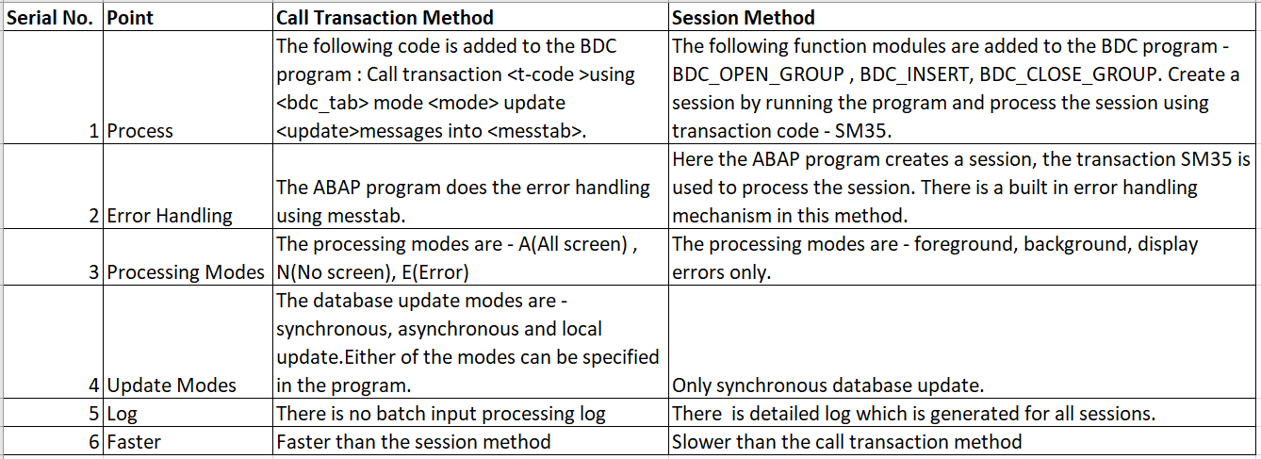
Call Transaction Method and Session Method Comparison
The below table shows the comparison of call transaction method and session method.

Slide 18
Direct Input Method
Direct input method are standard SAP programs to post the data in to SAP.
This method update the database tables directly.
This method is fast as compared to batch input methods(call transaction method and session method).

Slide 19
Direct Input Method(Contd.)
The few examples of direct input programs are as follows :
RFBIBL00 - FI(Finance)
RMDATIND - MM(Material Management)
RVAFSS00 – SD(Sales & Distribution)

Slide 20
LSMW- Introduction
LSMW stands for ‘Legacy System Migration Workbench’.
It is an ABAP workbench tool which is used to transfer data from Non-SAP( legacy) system to SAP system.
The transaction code for LSMW is LSMW.
LSMW works best for master data as one doesn’t require much coding while using LSMW.

Slide 21
LSMW- Introduction(Contd.)
This method is preferred by functional SAP consultants rather than technical consultants for data migration.
We can export and import a LSMW.
The difference between a LSMW and BDC is - LSMW is for functional consultants which does not require much coding whereas BDC is designated for technical consultants which requires coding.

Slide 22
LSMW Creation
While creating LSMW we need to provide 3 things:
Project - Specifies the name of the data transfer project. More than one subproject can be assigned to a project.
Subproject - Specifies the name of the subproject. A subproject can have unlimited number of objects.
Object - An object corresponds to a business object. Examples- Material Master, Client Master etc. An object is assigned to a subproject.

Slide 23
LSMW Methods
The various LSMW methods are as follows:
Direct input
Batch input recording
Business object method(BAPI)
IDOC(intermediate document)

Slide 24
BAPI - Introduction
BAPI stands for ‘Business Application Programming Interface’.
It is a technique which is used to conduct large scale data migration from Non-SAP(legacy) system to SAP system.
BAPI’s in the SAP systems are implemented as functional modules.
BAPI is a function module having a business object.
BAPI is always preferable as compared to BDC for data migration.

Slide 25
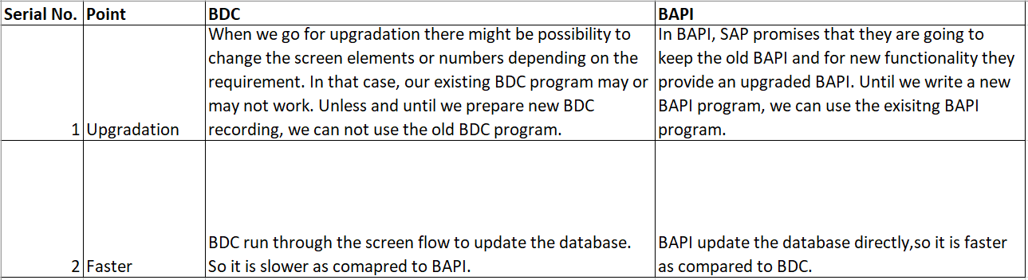
Advantages of BAPI over BDC
The below table shows the advantages of BAPI over BDC.

Slide 26
Steps to Add Custom Fields to BAPI
SAP provided the provision to add custom fields to the standard BAPI.
The various steps to add custom fields to the standard BAPI are as follows:
Add the custom fields to BAPI extension structures.
Add the custom fields to SAP standard tables.
Use the parameters EXTENSIONIN/EXTENSIONINX of the standard BAPI to pass the values of the custom fields.

Slide 27
Thank You

